Slide 1
Banking Record System:
Submitted by:
Md. Sakhawat Hossain
ID: 16172103046
Md. Nayim Islam
ID: 16172103033
Md: Mahadi Hasan Khan
ID: 16172103028
Mst: Laboni Khatun
ID: 16172103214
Supervised To :
Md. Masudul Islam
Lecturer, Dept. of CSE
BUBT

Slide 2
Introduction:
The Bank Account Management System is an application for maintaining a person's account in a bank. In this project I tried to show the working of a banking account system and cover the basic functionality of a Bank Account Management System.

Slide 3
Abstract:
Access to privilege banking zone.
Dedicated Relationship Manager.
Facility to link with current account
Anywhere banking with higher limits.
Daily account balance alerts.

Slide 4
Feature:
The feature of banking record system are:
1. Add Record:
2. Show/List Data:
3. Search Record:
4. Edit Record:
5. Delete Record:

Slide 5
Existing System Analysis
1. Bank Account Management System:
Website Link: www.researchgate.net
2. Banking Record System.
Website Link: WWW.yesfreeprojects.blogspot.com

Slide 6
Tools & Technology:
Serial No. | Name
1. | code blocks
2. | Processor
3. | Main Memory(RAM)
4. | Hard Disk
5. | Operating System

Slide 7
Literature Review:
Object Oriented Programming (OOP):
Data Abstraction.
Polymorphism.
Inheritance
Class:
Object:
Private:
Public:
Protected:

Slide 8
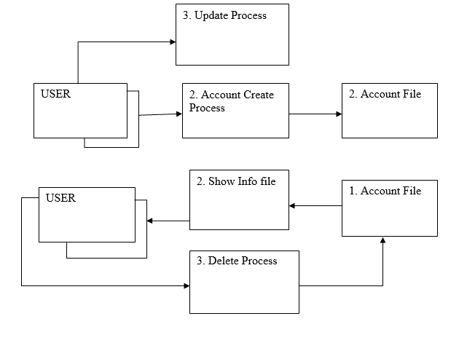
Data Flow Diagram (DFD):

Slide 9
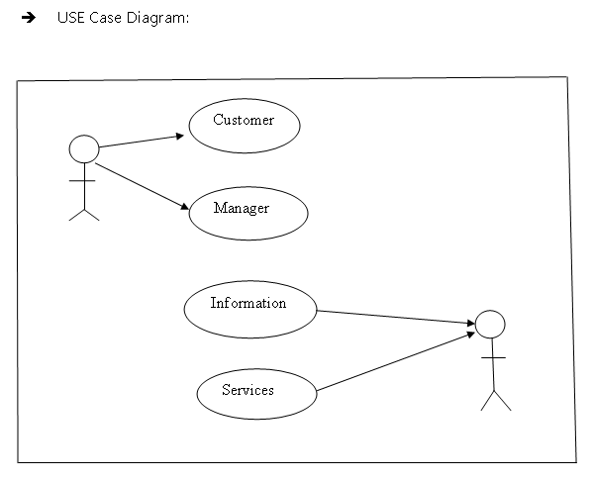
System Design:

Slide 10
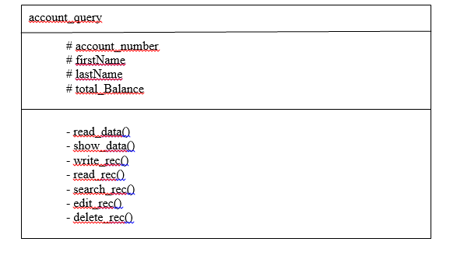
UML Class Diagram :

Slide 11
Software & Hardware Requirements:
Processor : Intel Pentium III or later
Main Memory (RAM) : 256 MB
Cache Memory : 512 KB
Monitor : 14 inch Color Monitor
Keyboard : 108 Keys
Mouse : Optical Mouse
Hard Disk : 160 GB
Operating System : Windows 7, 8, 9, 10, XP

Slide 12

Implementation:
The project view are :

Slide 13
Thank you

